Slide 1
Notes:
Title Slide: IN THE BEGINNING….Genesis 1:1

Slide 2
“In the Beginning”
Time
Time as we know it had a beginning. Titus 1:2
Ecclesiastes 3:11, “He hath made everything beautiful in its time: also he hath set eternity in their heart, yet so that man cannot find out the work that God hath done from the beginning even to the end.”
Notes:
Faith and hope are connected to time. We learn from the past. We live by faith (present) and we move by hope (anticipation of future). Hope is forward looking faith (Hebrews 11:1; Romans 8:24, 25). It is not that we live in the future, but rather that we through faith anticipate a certain future whereby we move with hope.

Slide 3
“In the Beginning”
Time
May only move forward, but identified in three ways:
Past (Learn from, remember – Romans 15:4).
Present (Live in Faith – 2 Corinthians 5:7).
Future (Looks forward, anticipate, fear, hope – Hebrews 11:1; Romans 8:24-25).
Notes:
Faith and hope are connected to time. We learn from the past. We live by faith (present) and we move by hope (anticipation of future). Hope is forward looking faith (Hebrews 11:1; Romans 8:24, 25). It is not that we live in the future, but rather that we through faith anticipate a certain future whereby we move with hope.

Slide 4
“In The Beginning GOD …”
While the universe and everything in it needed a beginning, God does not.
Asking “Who created God” would be as silly as asking “Who created the Creator?”
Only the answer of a Creator – God can solve the riddle as to “how” and “why” the universe exists.
NOT “in the beginning God was created.”
God existed before the beginning (time).
Notes:
Since He is the Creator-God, He does not need to be created. Things with a beginning had a cause. Your life and your parents’ lives and your grand-parents’ all had a beginning. You were caused to come into this world. Your birthday celebrates your time of entrance into this world by birth. However, God had no beginning and therefore He has no “birthday.” Nothing started God. He has always existed and that is what makes Him God.
We do not worship God because He needs us, but we need Him. We need to discover Him. This is why Jesus came to earth, that we might find God and turn to Him (Acts 17:25-28; Jn. 1:18; 14:16-11; 17:6; 1 Jn. 5:20; Jn. 14:21).

Slide 5
“In The Beginning GOD …”
What can we know about God?
General Revelation: Romans 1:18-20; Psalms 19:1-6
Look at the things that are made.
Order, Design, Intelligence.
See invisible things.
Eternal Power: That which brought into existence the universe and now controls it.
Divine nature: Supreme intelligence and will which directed and continues to direct the power.
Man Is Without Excuse!

Slide 6
“In The Beginning GOD …”
What can we know about God?
Special Revelation. Romans 1:16; 2 Timothy 3:16-17; Psalms 19:7-14
The revelation of His will in the mighty acts of history and in Christ can only be known from the Bible. cf. 1 Corinthians 2:11

Slide 7
“God”
“God” (Hebrew Elohim) teaches a plurality of persons in God.
John 17:5; 20:17; Hebrews 1:8-9; Matthew 3:17; Hebrews 1:1,2
John 5:23; Genesis 1:2; Acts 5:3, 4
Father
Son
Holy Spirit
Notes:
GOD…plurality...God existed before TIME Began
John17:5—glory before world began
Hebrews1:8,9—anointed by Father
Matt.3:17—His baptism—all three
Hebrews1:1,2—speaks through His Son
John5:23—Honor Father—must honor Son
Genesis1:2—Spirit of God on face of waters
Acts 5:3,4—H.S. refer to as God

Slide 8
“Created”
Tells of the original energy source for the creation — the infinite power of God! Psalms 33:6-9; Psalms 8; Romans 11:33-36; Revelation 4:8, 11
Hebrew bara found three times in Genesis 1.
Material substance (1:1)
Living substance (1:21)
Imperishable substance (1:27)
Signifies the creation of something which previously did not exist. Hebrews 11:3, “By faith we understand that the worlds have been framed by the word of God, so that what is seen hath not been made out of things which appear.”
Notes:
Not a random act of chance. A personally purposed work—Planned and Purposed—with intelligent design..

Slide 9
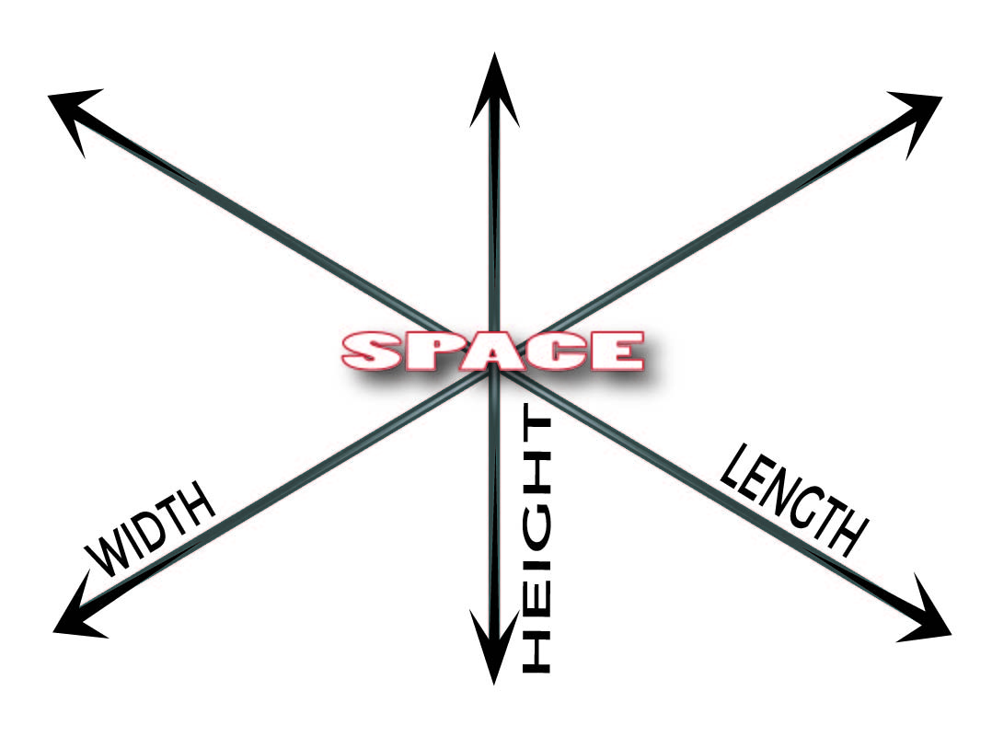
“The Heavens”
Space
Not nothingness.
One of the dimensions of our universe.
Observed in three dimensions.
Idea of stretching out the heavens. Isaiah 40:22
Genesis 1:8; 1:17
Notes:
We would measure the space of a room by such. Even our place one earth is measured by longitude, latitude, and elevation. Where in time we can only move forward, in space we can move up/down, side to side, forward and backward. Space is in three dimensions and yet one which may remind us of the three persons who make up God and yet He is also one.

Slide 10
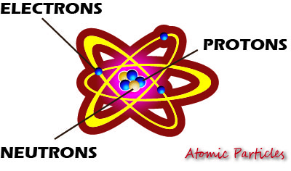
“And The Earth”
Matter
The way the universe functions is the signature from the Divine Creator.
Hebrews 1:3
Romans 1:18-20
How much energy would be released if every atom were split?
Notes:
Matter is made up of atoms which also has the three in one signature of electrons, protons and neutrons. Only hydrogen is the exception with only one electron and one proton.
Notice the word “power” in both these verses. The etymology of our word “dynamite” originates from this word. He upholds all things by the word of His power. Paul tells us that even the attributes of God’s eternal power and Godhead are seen in the things that are made. In looking at the atom which all matter is composed of, there is not only the signature of the triune God, but a pointer to His everlasting power.
Here are some fun fact that I saw from a PBS.org (The Power of Tiny Things; http://www.pbs.org/wgbh/nova/einstein/tiny-answers.html). This article noted that despite the fact that there is no way to convert a .03 ounce paperclip to energy as such would require temperatures and pressures greater than those at the core of our sun, but if you could, how much energy would that equal using Einstein’s E=mc²? Is it equal to the amount of burning 20 gallons of gasoline? Is it equal to one ton of TNT? If you could harness its power by turning every one of its atoms into pure energy it would yield about 18 kilotons of TNT. That is about the size of the atomic bomb that destroyed Hiroshima. One hundred pennies would have enough power to power the entire state of New York for two days! So, who put that power there? Where did it come from? The one who put it there has the power to dissolve it (2 Peter 3:10). Peter was not a nuclear physicist, but was inspired to write this letter by the One who created the nucleolus and the dissolving of the elements by the Creator ought to be a fearful thing to us.

Slide 11
The Answer of “God!”
Solves the riddle as to “how” and “why” the universe came into existence.
Nature cries out that there was a beginning.
Nature alone does not answer how the beginning began — resulting in endless speculation.
Bible answers that the beginning began with an eternal God
Notes:
God’s Answer—To the question—Where did it begin?

